Slide 1
Chapter One
Safe Diving and the Diver

Slide 2
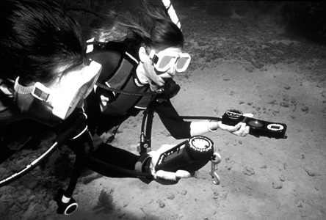
Topics In This Chapter
The Self-Reliant Diver
Awareness
Preparing for the Dive
Dive Planning
Buddy Check
Out-of-Air Emergencies
Limited Visibility

Slide 3
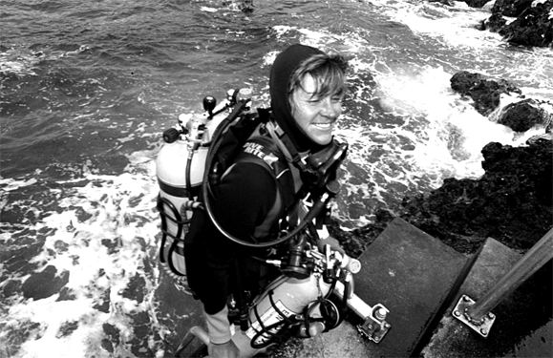
The Self-Reliant Diver
What is meant by the term “self-reliant” ?
The ability to look after all your problems underwater without assistance from your buddy

Slide 4
The Self-Reliant Diver
Critical elements in developing self-reliance
Understand your equipment
Take personal responsibility
Develop self-awareness skills
Become more aware of your surroundings
Plan for contingencies
Learn to handle your own emergencies

Slide 5
The Self-Reliant Diver
Through training and experience, all divers
should strive for self-reliance
First, you should be able to take care of yourself in most situations
Then, you will be better prepared to assist another diver with any problems that arise

Slide 6
Awareness
Self awareness
How cold or tired are you ?
How are you and your equipment working together, as a system ?
What is your remaining air supply ?
What is your current depth ?
What is your remaining NDL ?

Slide 7
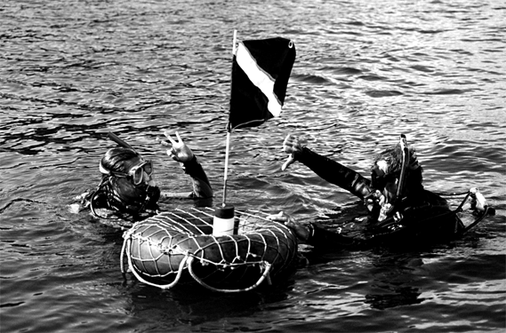
Awareness
Global awareness
Orientation and sense of direction
Recognize and evade entanglement hazards
Judge distance from bottom, and avoid stirring up silt
Stay in sync with buddy, without getting in the way
Instinctively pick the best navigational clues

Slide 8
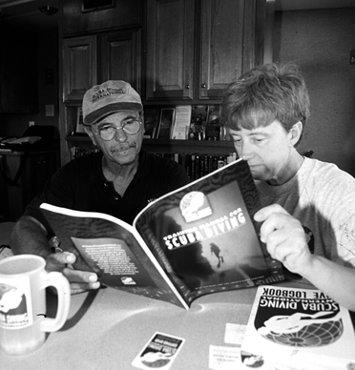
Preparing for the Dive
Physical preparation
Appropriate level of physical fitness for typical diving activities
Rescue scenarios often will require an increased physical effort

Slide 9
Preparing for the Dive
Mental preparation
Evaluate conditions, in terms of personal experience and training
Mentally “walk” through the planned dive
with your buddy
Anticipate possible problems, and identify appropriate responses

Slide 10
Preparing for the Dive
Equipment preparation
Appropriate annual servicing of scuba gear
Personal pre-dive inspection of all items
Regulator system
Buoyancy compensator
Personal dive computer and gauges
Exposure protection
Accessory items, required for a particular dive
Lights, reels, lift bags
Surface floats and flags, signaling devices
Cutting tools

Slide 11
Dive Planning
Detailed plan, agreed upon by all buddies
Objective: intent and nature of this dive
Maximum depth and time limits
Safety stop
Adequate air supplies
Route to follow, including entry and exit points
Hand signals

Slide 12
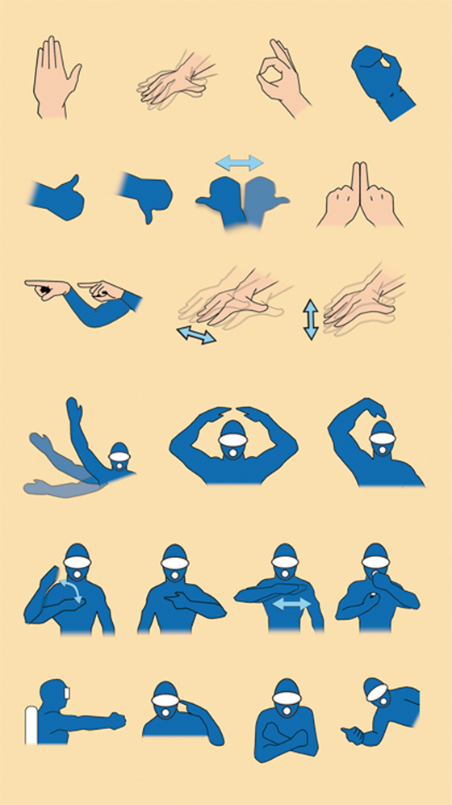
Diving Hand Signals

Slide 13
Buddy Check
Should be performed before every dive
Are BC straps and buckles fastened ?
Is air on, and is tank full ?
Are all hoses properly routed ?
Alternate air source: type, location, use ?
Is mask sealed, and are straps secure ?
Is weight system release accessible ?
Is dive knife or tool in place ?

Slide 14
Buddy Check
Continued . . .
Have hand signals been reviewed ?
Has dive plan been reviewed ?
Have contingency plans been reviewed ?

Slide 15
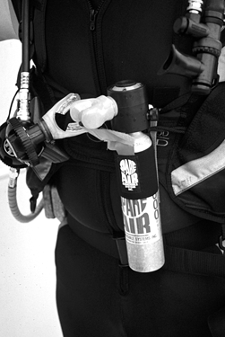
Out-of-Air Emergencies Buddy Dependent Options
Alternate air source / octopus regulator
Diver signals “out of air” and “share air”
Donor passes octopus and/or receiver reaches for octopus
Each grasps other’s BC strap with right hand
Maintain eye contact, ascend together
Vent air from BC during ascent with left hand
Establish positive buoyancy at surface

Slide 16
Out-of-Air Emergencies Buddy Dependent Options
Special note: inflator-integrated alternate
regulators
Donor must pass primary regulator, while switching to alternate
Otherwise, follow same procedure as with octopus regulator

Slide 17
Out-of-Air Emergencies Buddy Dependent Options
Buddy breathing
Diver signals “out of air” and “share air”
Donor takes a breath, before passing second stage
Each diver takes two breaths, on alternating basis
Each diver exhales slightly while without regulator
One hand used to grasp buddy’s BC strap, and other hand to pass regulator (do not cover purge)
Maintain eye contact, ascend together
Vent air from BC during ascent
Establish positive buoyancy at surface

Slide 18
Out-of-Air Emergencies Buddy Independent Options
Redundant air supplies
Pony bottle, with separate regulator system
Self-contained units, such as Spare Air ®

Slide 19
Out-of-Air Emergencies Buddy Independent Options
Direct emergency ascent
Considering the time required for some of the other options, a direct ascent might make more sense with less risk to either diver
Procedures
Basically ascend normally, while exhaling slightly
Be ready to discard weights, if necessary, during ascent
Decreasing ambient pressure may allow an additional breath

Slide 20
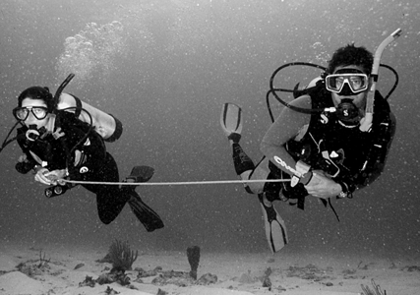
Limited Visibility
Avoid buddy separation
Stay within arm’s reach of each other
When appropriate, use a buddy line

Slide 21
Limited Visibility
Lost buddy search
Stop, immediately look around
Ascend a little, and look for buddy’s bubbles
Back-track a little, to see if buddy stopped
Search only for about one minute
If you can’t locate buddy, ascend to surface
If buddy does not appear after several minutes, summon assistance

Slide 22
Limited Visibility
Navigation skills
Especially important in poor visibility
May be required in rescue searches
Techniques
Visualize your dive plan
Visualize your environment
Superimpose both images
Calculate your progress
Plot your position on the dive plan
Use natural and instrument aids

Slide 23
Summary
Elements of safe diving
Self-Reliance, through training and experience
Awareness: personal and global
Proper preparation
Proper dive planning
Pre-dive buddy check

Slide 24
Scuba I.Q. Review

Slide 25
Scuba I.Q. Review
1
Q
What does the term “self-reliant” diver mean?
A
The ability to look after all your problems underwater without assistance from your buddy

Slide 26
Scuba I.Q. Review
2
Q
A diver’s sense of awareness underwater is made up of what two components?
A
self awareness, global awareness

Slide 27
Scuba I.Q. Review
3
Q
List three essential parts of a good dive plan.
A
physical preparation, mental preparation, equipment preparation

Slide 28
Scuba I.Q. Review
4
Q
When might a diver favor a buddy-independent response to a buddy-dependent response in an out-of-air emergency?
A
In depths of less than 30ft (9m), the surface is only seconds away; considering the time it might take to employ another option, a direct ascent might make more sense with less risk to either diver

Slide 29
Scuba I.Q. Review
5
Q
Describe two self-rescue options for an out-of-air diver at a depth of 6 m/ 20ft.
A
redundant supply ascent, direct ascent

Slide 30
Any Questions ?

